Slide 1
Extending EWAS: Genomic Feature & Pathway Enrichment and Causal Inference
Dr. Cavin Ward-Caviness
US EPA – Environmental Public Health Division, Clinical Research Branch

Slide 2
What is an EWAS
Epigenome-wide association study = EWAS
Done to see if epigenetic variation anywhere in the epigenome is associated with a trait or exposure
The epigenetic extension of GWAS but with additional caveats

Slide 3
EWAS Considerations
Data Cleaning
Poor hybridization, low intensity, cross-hybridizing, probes with SNPs, batch effects, sex mismatches, probe chemistry harmonization
Cell type heterogeneity
Target tissue
Scale of effect
Integration with gene expression / other omics data
Timing in relation to exposure / outcome

Slide 4
Questions to ask after you have performed an EWAS
Are there genomic regions which are enriched for associations?
Are gene ontologies or pathways enriched for associations?
Is there evidence for a causal effect?

Slide 5
Genomic regions/features with potential functional significance
CpG islands vs Shore (0 – 2kb) vs Shelf (2 – 4kb)
Islands are regions typically near promotors which have a high density of CpG sites. Shores and shelves are nearby regions to the island
Enhancers
Long range regulatory elements that can be up to 1Mbp from the gene they regulate
5’/3’ Untranslated region
Regions near the start/stop codons that may contain regulatory significance
Dnase I Hypersensitivity Site
Nucleosome free, i.e. open, regions of DNA where transcription factors and RNA polymerase can bind

Slide 6
In this example enrichment analyses might find that the Island and Enhancer are enriched for associations
N. Shore
S. Shore
Island
Nucleosome
Enhancer
Gene / Gene Body
Measured CpG
5’/3’ UTR

Slide 7
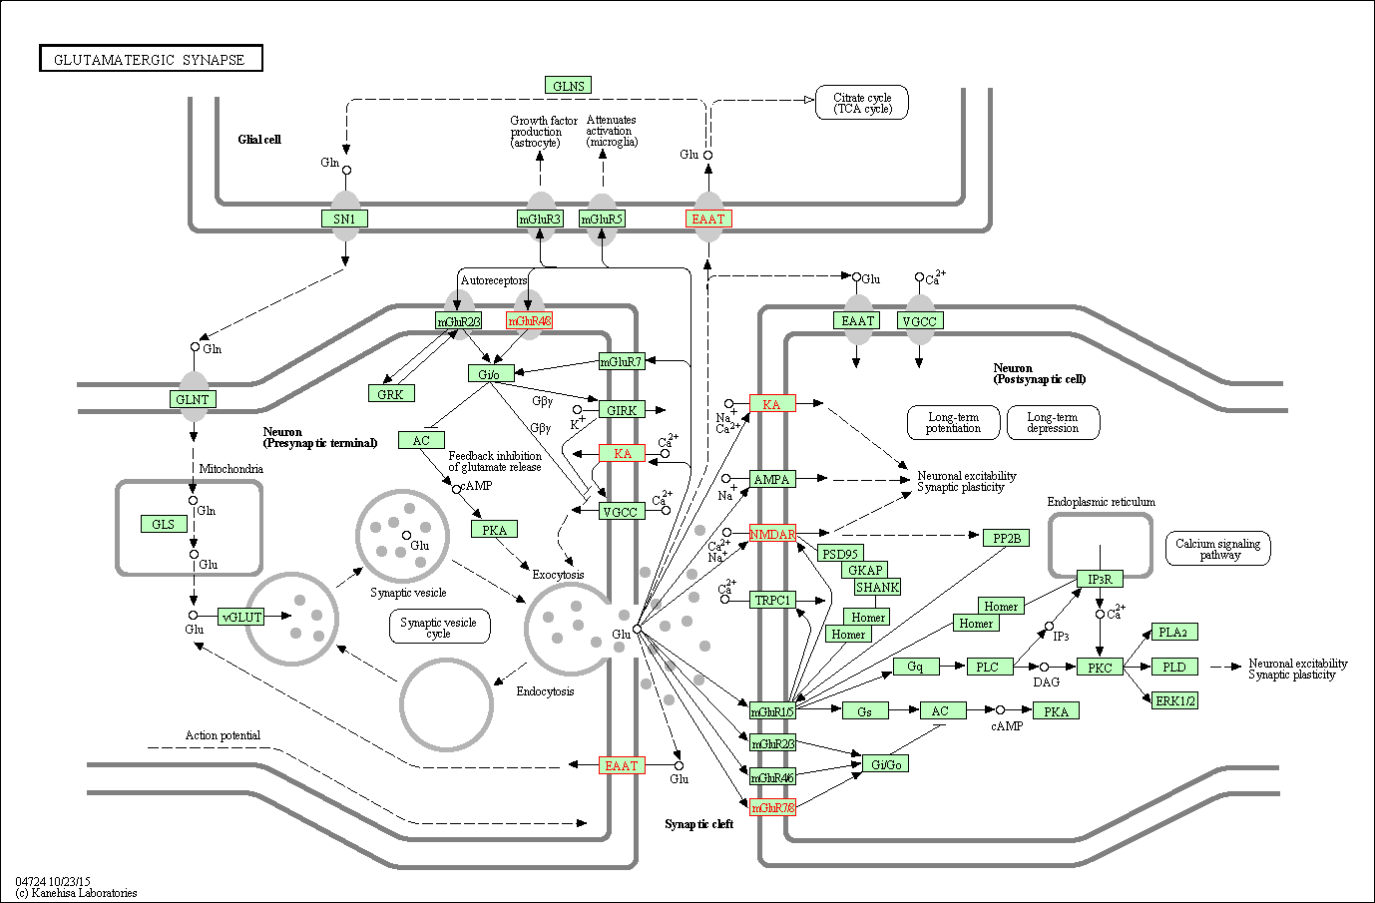
Gene Ontology/Pathway Analyses
Genes/gene regulation does not act alone but as a part of a larger pathway
Pathway associations are often more robust than locus or gene-specific associations
Enriched pathways/ontologies may better reflect biological significance
Gene Ontology = a set of genes with a common attribute: location, regulation, biochemical / biological function
Pathway = set of genes grouped by a common biochemical or biological function.

Slide 8
Things to consider with Enrichment analyses
One sided vs two-sided tests – Enrichment, Depletion or both?
What to use as a baseline?
What forms of bias exist?

Slide 9
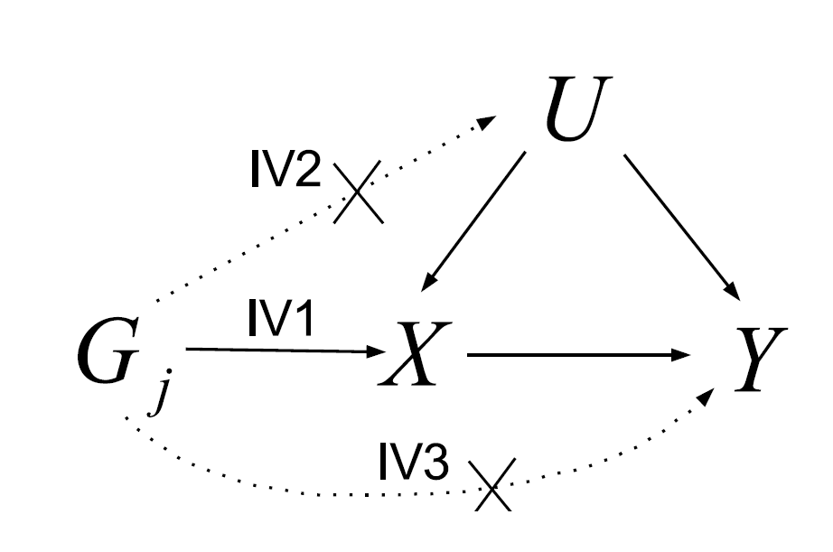
Casual Inference: Mendelian Randomization
G_{j} = Genotypes
U = Unmeasured confounding
X = Exposure of interest (CpG)
Y = Outcome
G_{j} assumed to be predictive of X (IV1); independent of U (random assignment at birth, IV2); and not directly associated with Y (IV3).
If all assumptions are met then the estimated effect of G_{j} on Y is an unbiased estimate of the causal effect of X on Y

Slide 10
Common Factors Affecting MR
Correlation amongst genetic variants
Use independent genetic variants only, explicitly account for correlations
Pleiotropy/Invalid instruments
MR Egger, MR PRESSO, Mode Based Estimate, etc…
Low Powered Instruments
Use multi-instrument approach
Winner’s curse / 1 sample MR
Two Sample MR (perhaps with summary data; www.mrbase.org)

